Slide 1

customer segmentation analysis
By: Hardik, 12109777, RK21DYA14
To : Prof. Tanima Thakur (28373)

Slide 2
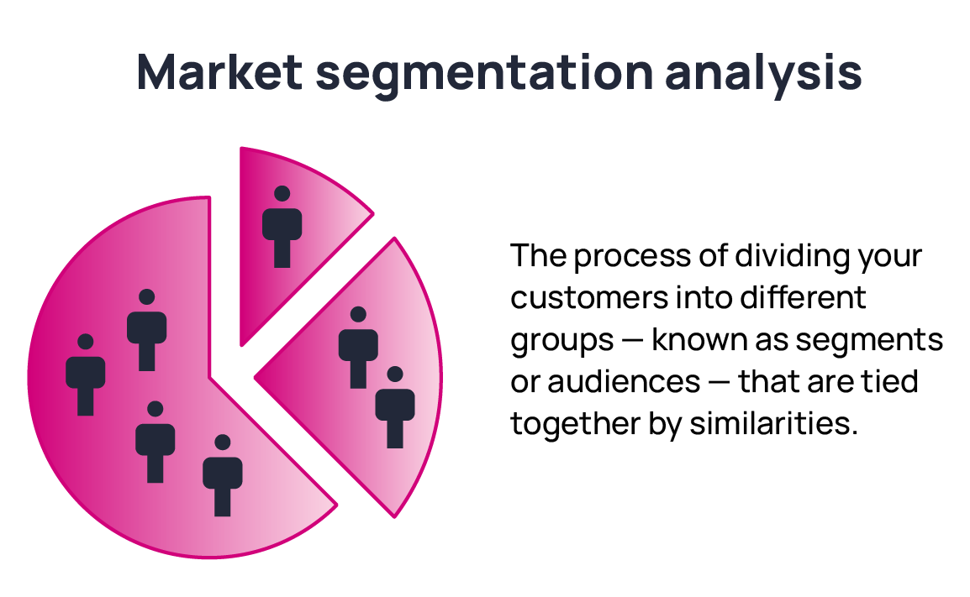
INTRODUCTION The purpose of this project is to perform customer segmentation analysis using a dataset containing demographic and behavioral information. Customer segmentation helps companies understand the unique needs of different customer groups, which can optimize marketing strategies, improve customer retention, and increase revenue by providing more personalized experiences.

Slide 3

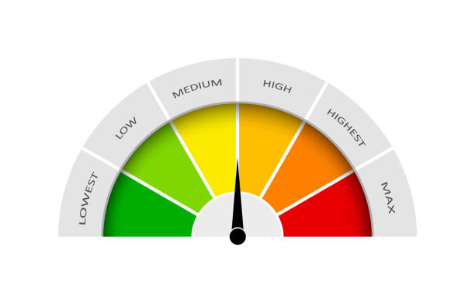
Objective of Analysis: This project aims to categorize customers based on their purchasing behaviors and demographics, enabling the identification of high-spending segments. By categorizing spending scores into "Low," "Medium," and "High," we can draw actionable insights to improve customer engagement. Our analysis will employ machine learning algorithms to predict spending behavior, evaluate their performance, and choose the most effective model.

Slide 4
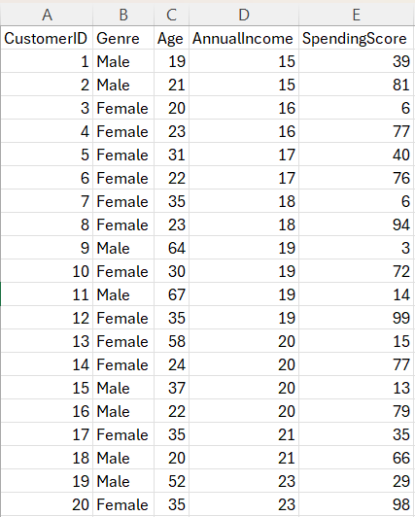
🗄️ Dataset Details
The dataset includes the following features:
1. CustomerID: Unique identifier for each customer.
2. Genre: Customer gender.
3. Age: Age of the customer, used to observe spending trends across age groups.
4. Annual Income: Customer's annual income, which serves as an indicator of purchasing power.
5. Spending Score: Based on customer behavior and purchasing patterns, categorized into "Low," "Medium," and "High." This is the target variable for predictive analysis.

Slide 5


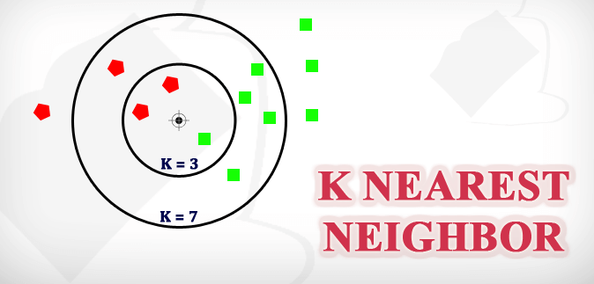

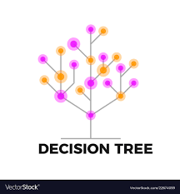
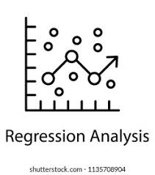
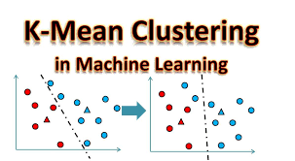
🧠 Algorithms Used

Slide 6
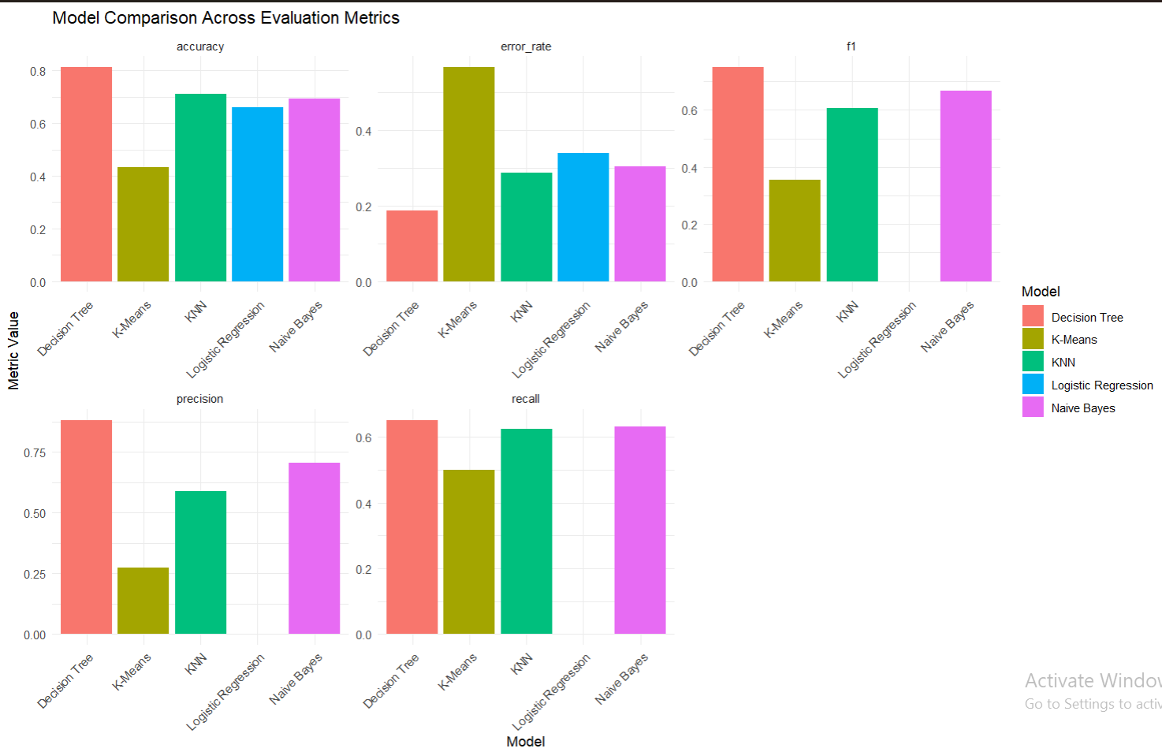
📊 Performance Comparison

Slide 7
Algorithm-Specific Insights
Knn (Effective for well-separated data)
Naïve Bayes (Probabilistic and efficient)
Decision Tree (High interpretability)
Logistic Regression (Binary predictions)
K-Means (Unsupervised insights)

Slide 8
Results and Visuals
Highlight results for each algorithm using visuals:
Decision Tree: High accuracy.
KNN: Moderate but insightful.
K-Means: Natural clusters revealed.

Slide 9

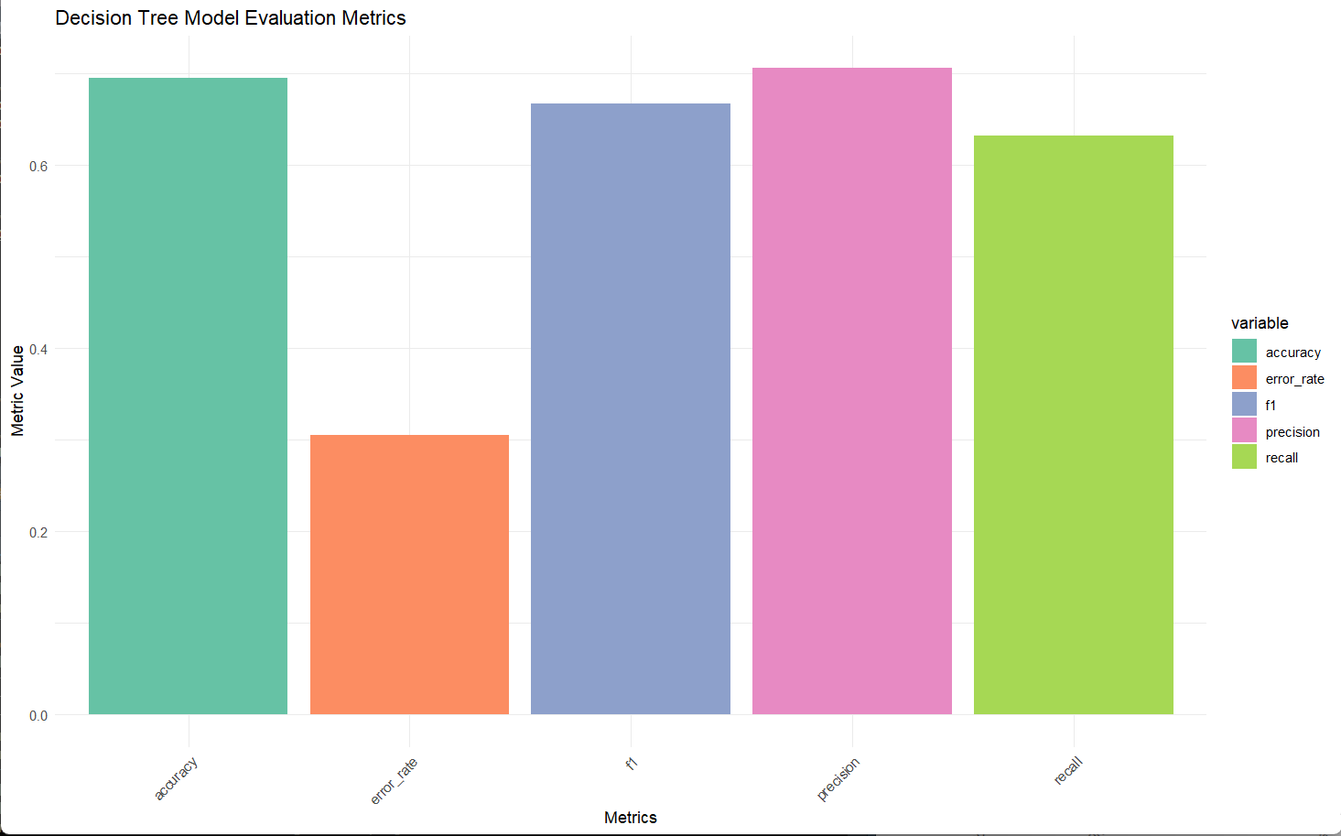
🔍 Conclusion
Each algorithm demonstrated unique strengths:
• Decision Tree and Naive Bayes models excelled in interpretability and provided good predictive accuracy.
• KNN and Logistic Regression offered alternative insights for binary and multi-class spending predictions.
• K-Means Clustering revealed natural groupings, adding value through unsupervised segmentation.
For practical applications in customer segmentation, the Decision Tree model may be most advantageous due to its high accuracy and straightforward interpretability

Slide 10

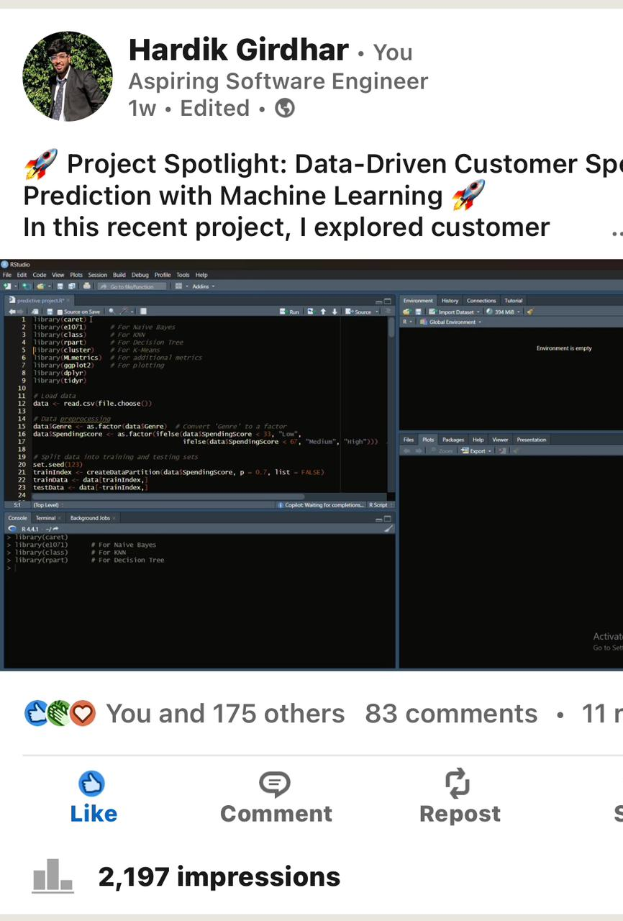
Explore More
GitHub: Hardik-Girdhar
LinkedIn: Hardik-Girdhar

Slide 11

THANK YOU

